Slide 1
Presentation to Hack 4Farming
July 29, 2016
Nairobi, Kenya

Slide 2
Key Components of a Seed Company
Product Development: Breeding, Testing and Agronomics
May be done in-house, or acquired from external sources
Production: Growing the seed crop
May be in-house, but ofter contracted to farmers with crop experience
Seed Processing: Cleaning, Drying and Packaging seed for sales
Ofter a combination of in-house and contracted efforts
Marketing and Sales
Usually through Dealers, Agro-Vets, even Farmer/Dealers

Slide 3
Product Classes for seeds
Varieties
Fixed Genetics
Farmers can and do replant, sell to neighbors, etc
Seed Companies have a difficult time making money from varieties
Reduced incentive for improvements
Hybrids
Genetics fixed for only one planting;
Farmers cannot replant
Seed must be purchased each season
Additional yield from heterosis (hybrid vigor) must be sufficient for farmers to make significantly higher profits to justify additional costs

Slide 4
The Added Value of Hybrids
Hybrids have significant potential to improve incomes
Seed has to be more expensive than for varieties; 5 to 10 times as much
Rice Hybrid data shows farmers can make an additional KES80,000 or more after paying for seed

Slide 5
SeedCo / Farmer interactions
Helping Farmers make profits
Amd holding on to customers
Lots of testing to pick pest hybrids
Incorporating best technology as a package; i.e. fertilizers, herbicides, fungicides
Improving farmer technology; direct seeding vs transplanting, post harvest treatment, etc
Adding information to help in decision making
Weather forcasts
Historical weather trends associated with their area, crop and cultivar
For Example: you planted hybrid “X” on your farm April 3. You have had 20% more rainfall than normal, so prepare to all extra “Mavuno Rice” this week. Order Now

Slide 6
Paying for Hybrid Seed
In the case of Rice, hybrid seed will be 5x more expensive than varieties: 20,000/= vs. 4,800/=
However, farmers will get a return on investment of 250% to 600%
Still the question is: how can small farmers pay 20,000 upfront for hybrid seed?

Slide 7
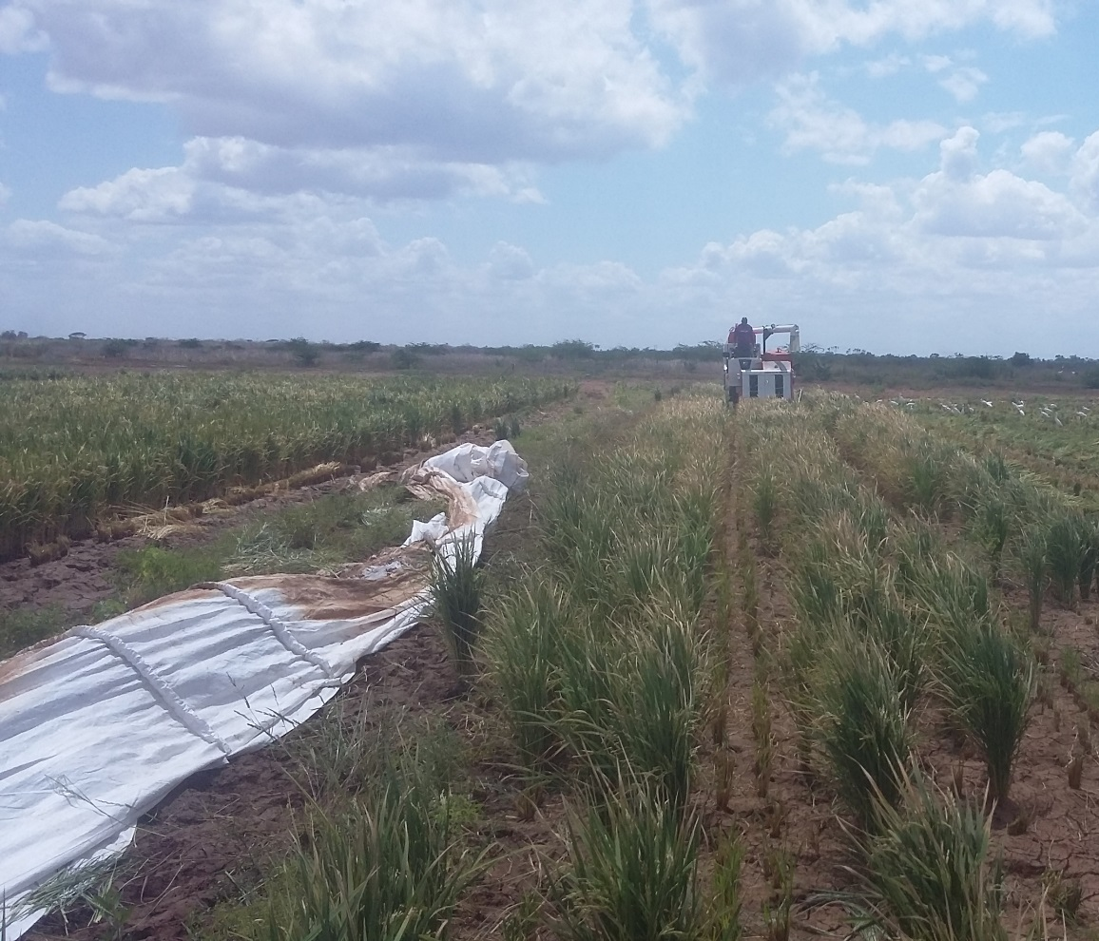
Options for Seed Payment
Cash on delivery
Perhaps 20% of farmers in Kenya
Bank or Microfinancing
Several institutions interested
Mill buyback
Mill sells the seed, and captures value plus carrying costs post harvest
Seed company collects port harvest

Slide 8
Keys to Seed Company Success
Providing better products, with assured product quality
Making purchasing easier
Providing farmers maximum information
Cultivar Choice
Agronomic practices
Complimentary products; fertilizers, etc
Weather forecasts, comparisons with last year, last 5 years, etc
Marketing information on prices, places etc
Making farmer customers more profitable so
They can help make the SeedCo more profitable

